Slide 1
Assessing spectral variability on asteroid surfaces
Presentation by Mary Bolling
Head researchers: Lauren McGraw, Josh Emery

Slide 2
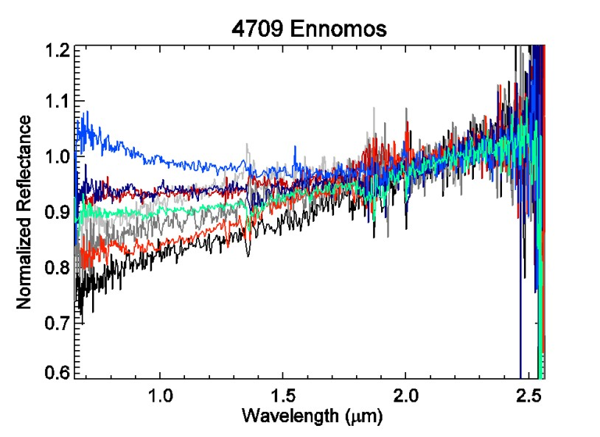
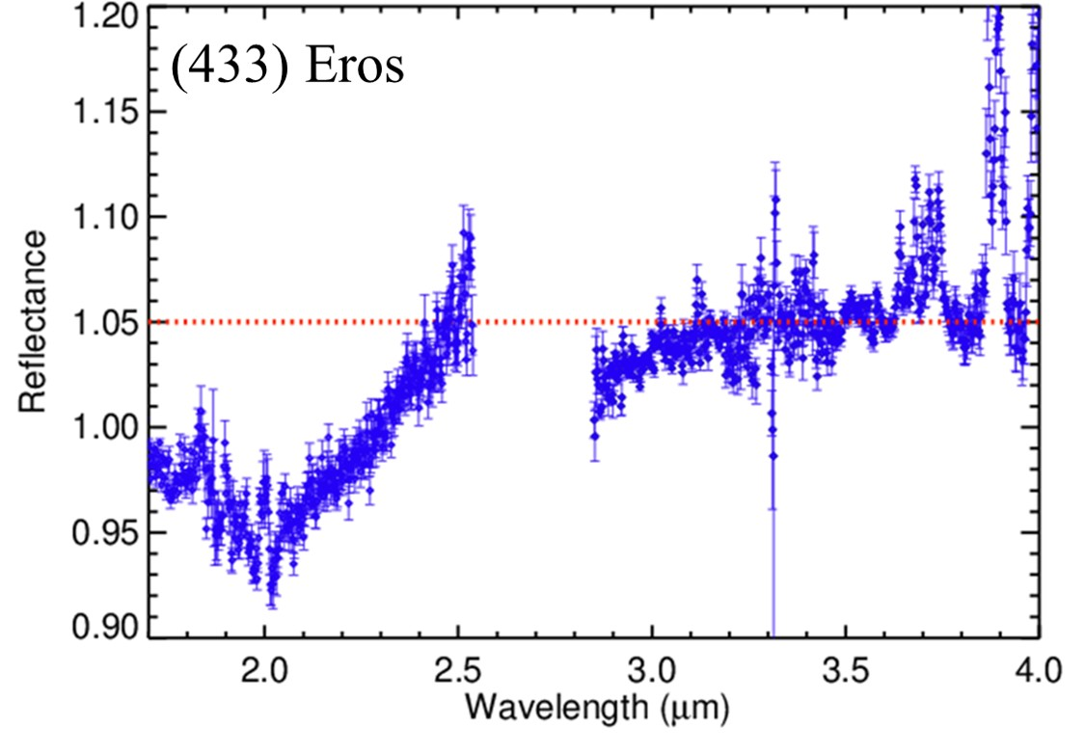
Objective
The spectroscopic data of certain airless bodies have been produced without proper mapping to the specific body’s topography. My goal is to use the light curves taken on these objects to map their spectral signatures to different physical features on their topography.
Notes:
NIR graph: Red spectra is from 2003, Black/grey spectra are from 2007, blue/green are from 2009 The cause for curiosity on Ennomos is the extreme variation of reflectance in the lower wavelengths.

Slide 3
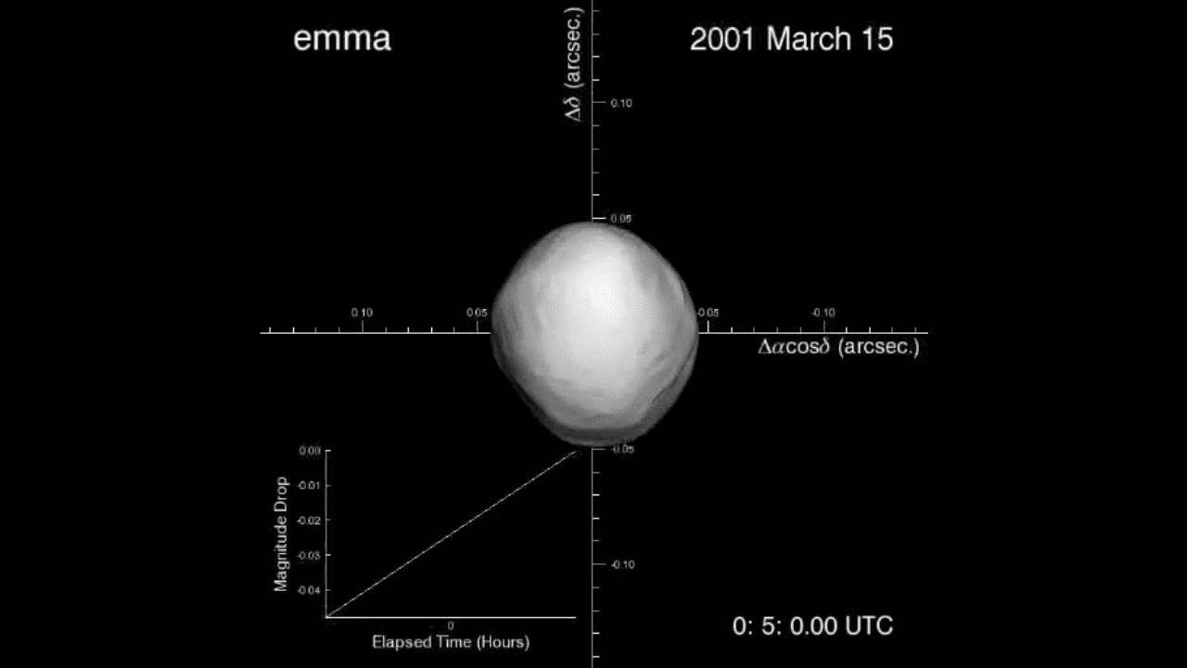
What a light curve is
Measures the brightness of an object over time
More indicative of an object’s shape than its chemical makeup
Can be used to determine what part of the asteroid was observed
Notes:
???????

Slide 4
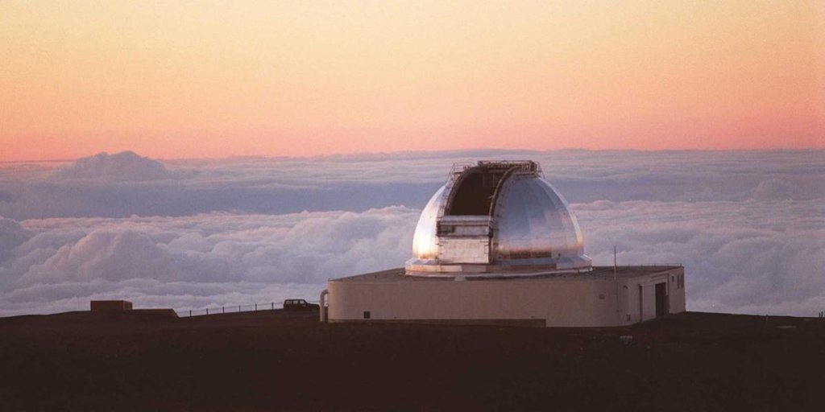
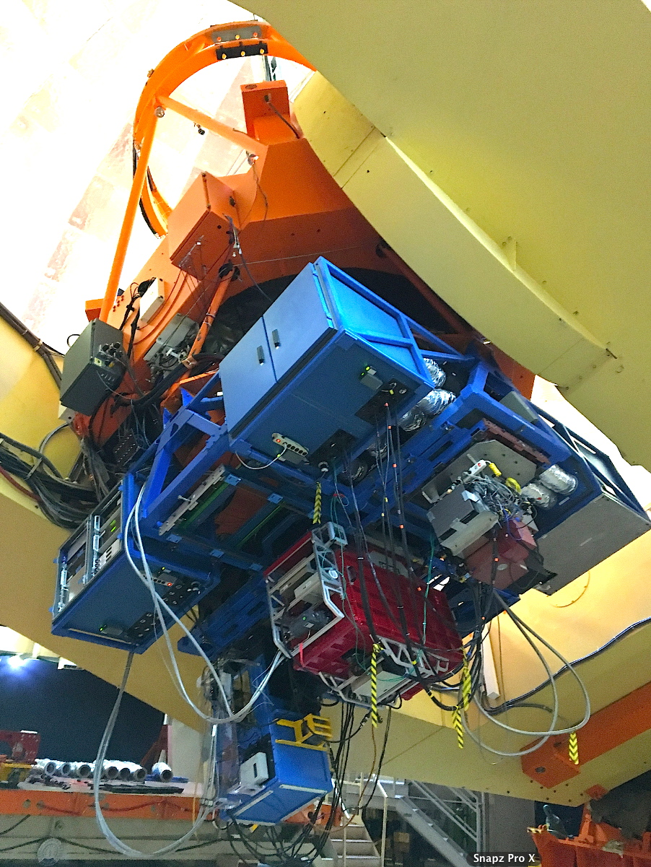
SpeX & MORIS
SpeX
A spectrograph capable of collecting light in the 0.7-4 μm range (NIR)
0.7-2.5 μm for Ennomos, 2-4 μm for Eros
MORIS
Visible wavelength (0.4-0.7 μm range) camera
The devices are located at the NASA IRTF in Hawaii.
SpeX
Notes:
The SpeX and MORIS instruments are mounted side-by-side at the NASA IRTF in Hawaii. Located on the Big Island, it is one of the telescopes comprising the Maunakea Observatory.

Slide 5
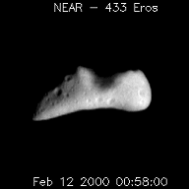
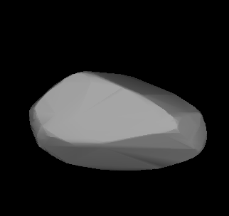
A little about Eros & Ennomos
Eros
Designated a Near-Earth Asteroid (NEA)
About 360 million km from Earth
About 17 km in diameter
Ennomos
Known as a Trojan asteroid
About 628 million km from Earth
About 81 km in diameter
Eros rotating, as imaged by the NEAR Shoemaker mission.
A 3D rendition of Ennomos
Notes:
Ennomos is orbiting in Jupier’s L₅ Lagrangian point, meaning it tails the gas giant

Slide 6
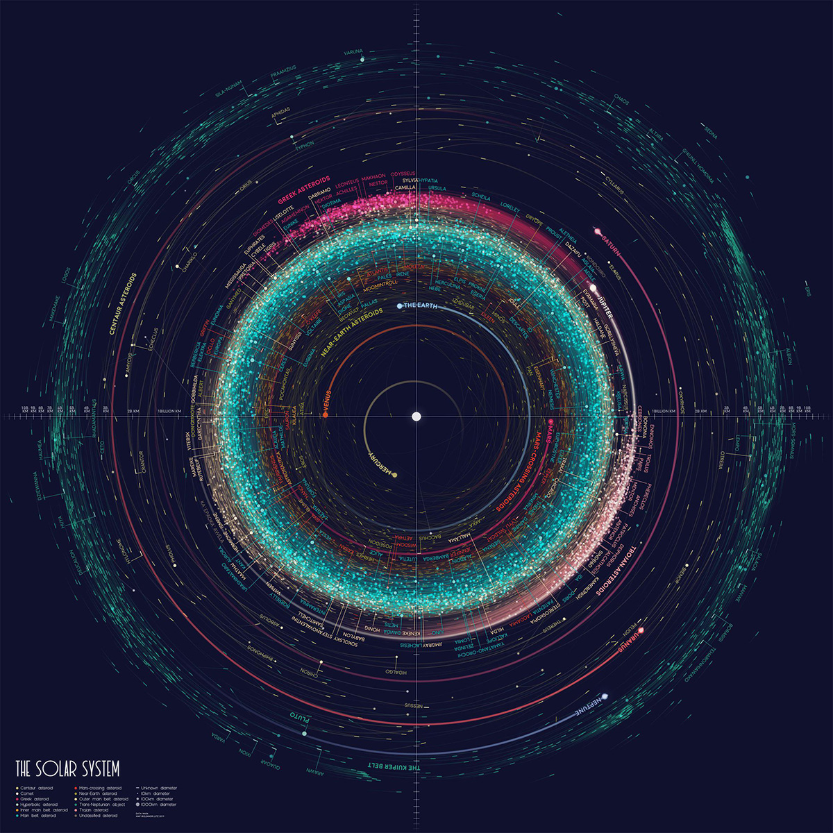
Earth
Eros
Ennomos
Image credit: Elanor Lutz

Slide 7
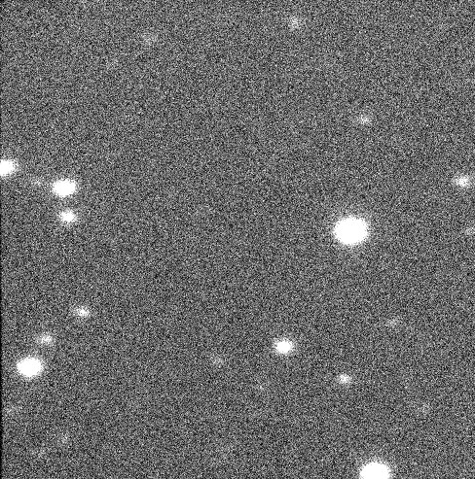
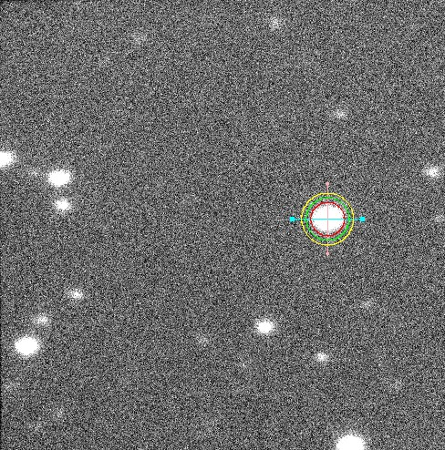
Photometry procedure
Object is identified
Aperture encompasses object
Inner and outer sky are used for comparison
Notes:
Once the object is found by the user, APT does photometry on it. Inner & outer sky radii are used to produce a value for the object’s intensity by subtracting out a “zero value” for the brightness of the sky around the object.

Slide 8
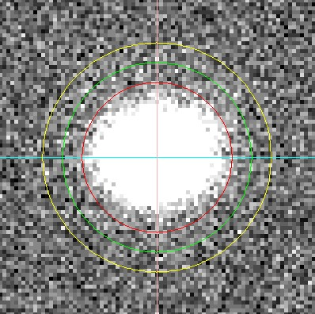
Inner sky
Aperture
Outer sky

Slide 9
Analysis
Object’s flux
Average of star’s flux
Known star magnitude
Python code ties it all together
Star and object frames with similar airmasses were used together in data reduction
m_{object} - m_{star} = 2.5log₁₀(F_{star}/F_{object})
m_{object} = 2.5log₁₀(F_{star}/F_{object}) + m_{star}
Notes:
m1 is the magnitude of the object that we desire, m2 is the magnitude of the star, and the respective subscripts indicate what flux, or “source intensity,” is from which object. Star frames and object frames were paired up via similarities in airmass, which is how much atmosphere is affecting how the object looks.

Slide 10
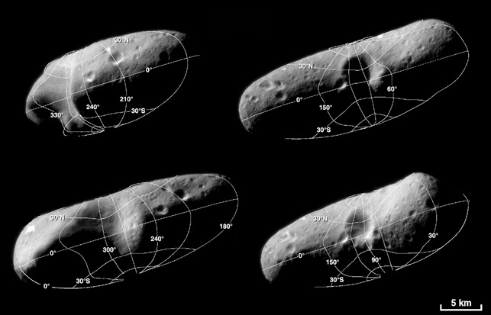
Results: Eros
Partial mapping of Eros was achieved. Longitude ranges from 22° E to 112° E, latitude was constant at 84° S.

Slide 11
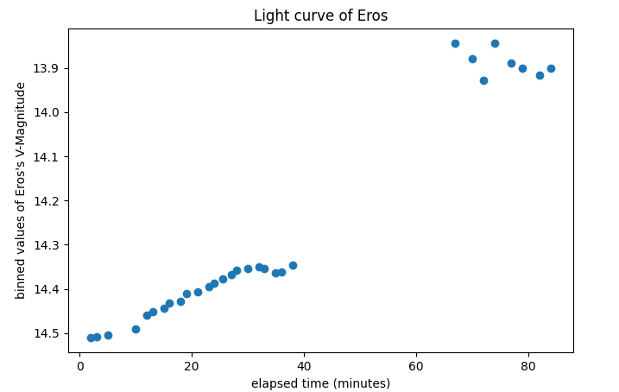
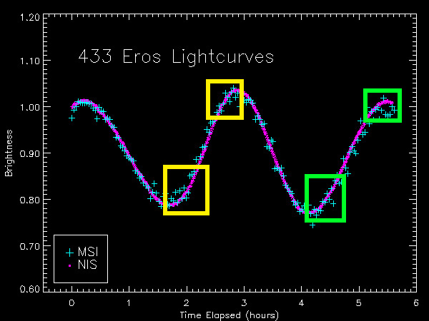
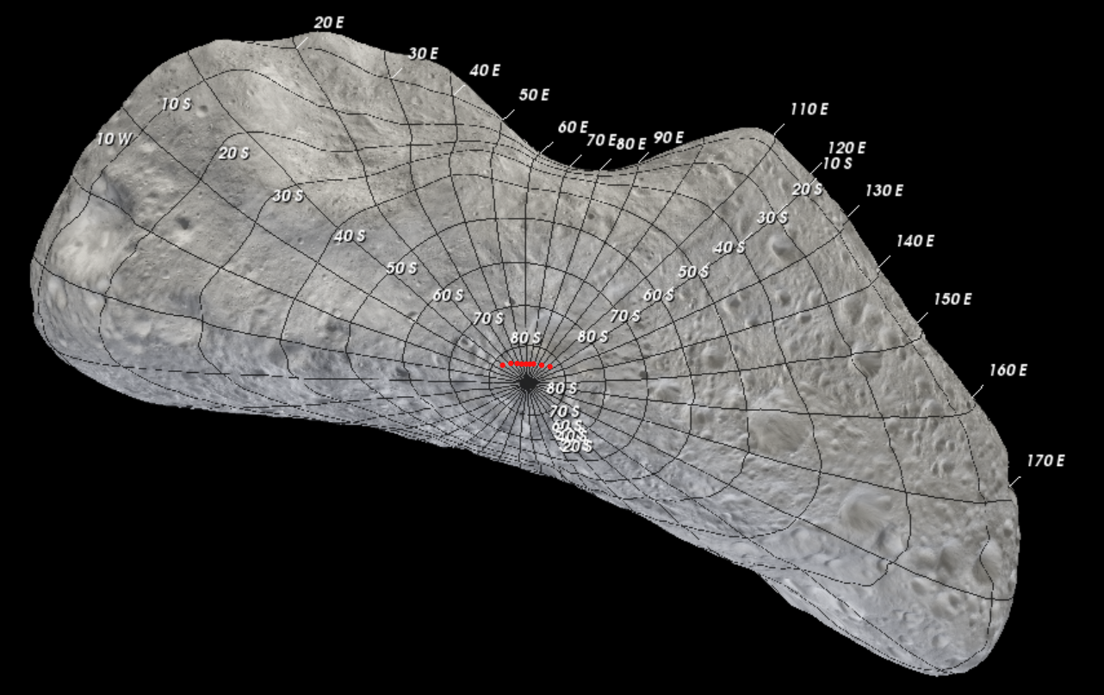

Slide 12
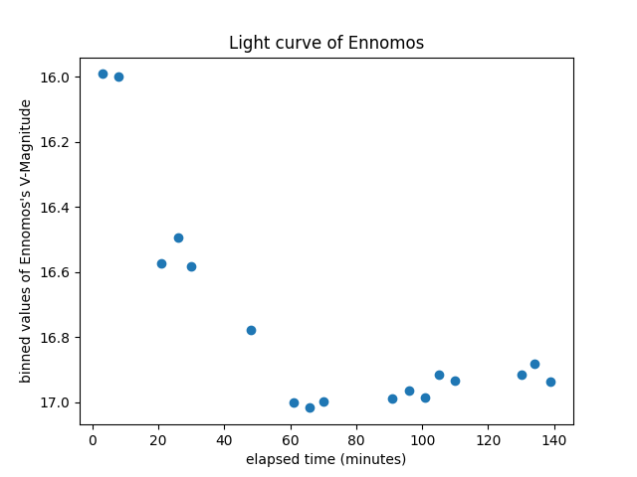
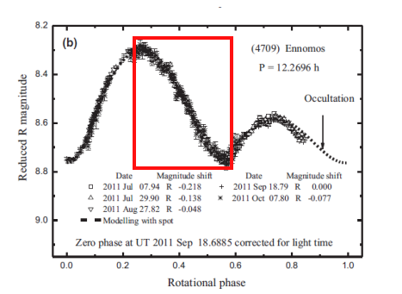
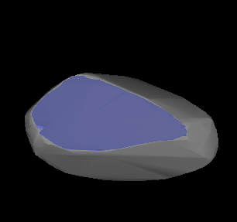
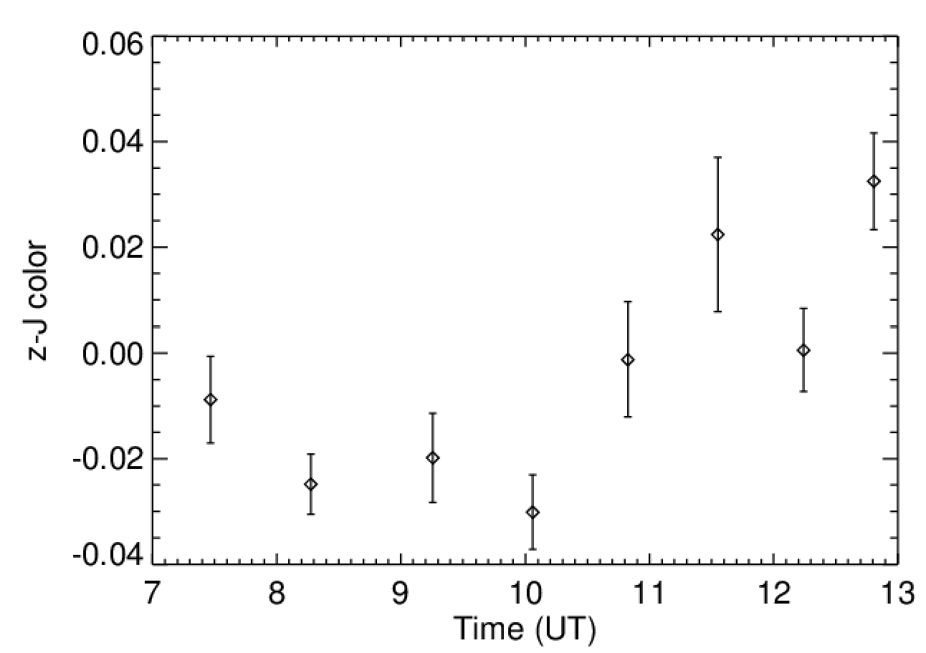
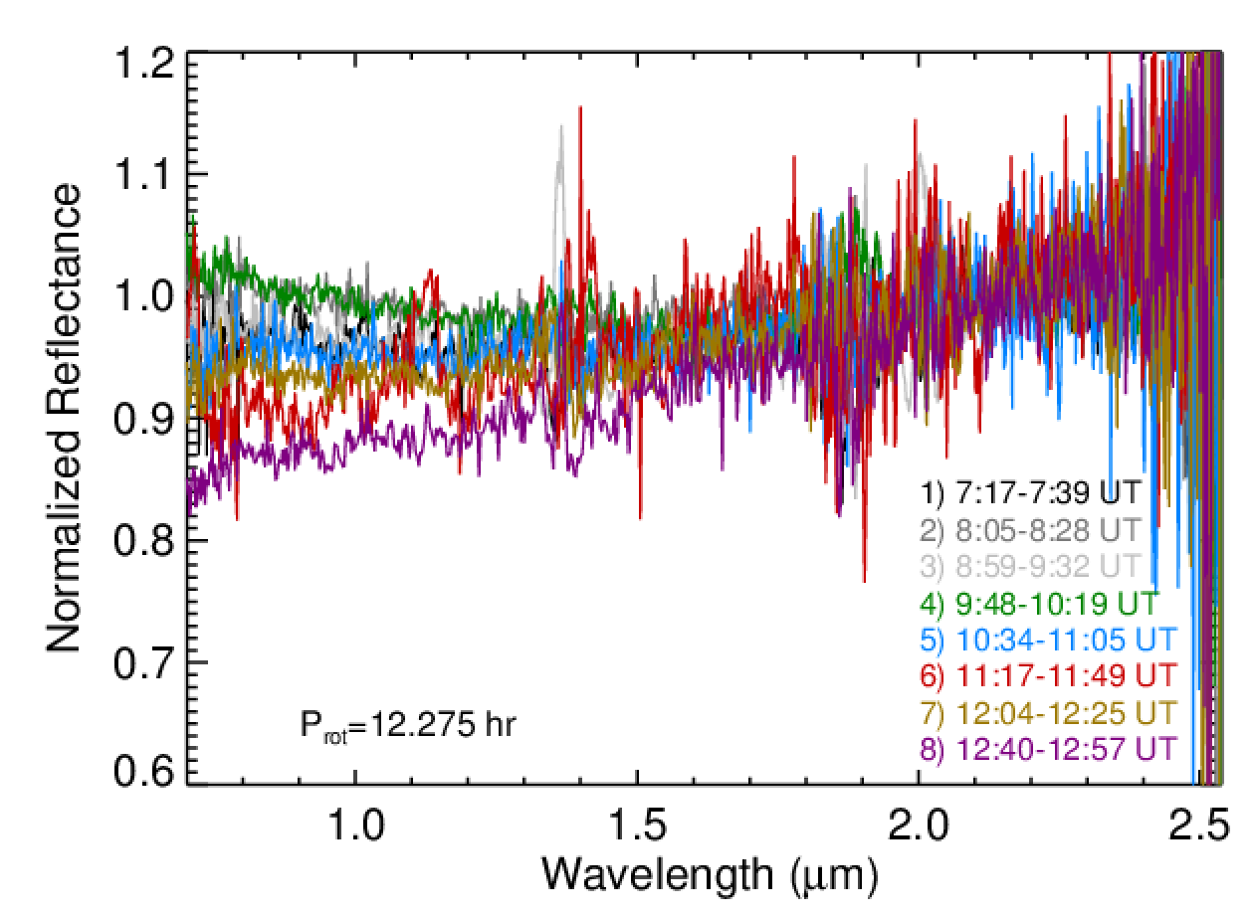
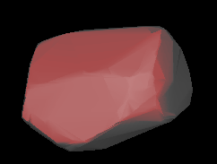
Results: Ennomos

Slide 13
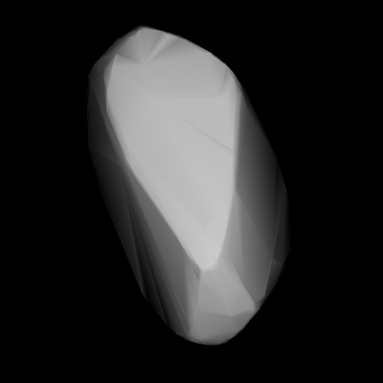

Slide 14
Conclusion
The surface of Eros contains volatiles, as predicted. Distribution over surface area is still unknown, but more data exists and can be worked on.
When Ennomos was observed, its bluer spectra came from the largest surface area of the asteroid and its redder spectra came from its smaller side.

Slide 15

https://tlw389.wixsite.com/nau-emerge

